Slide 1
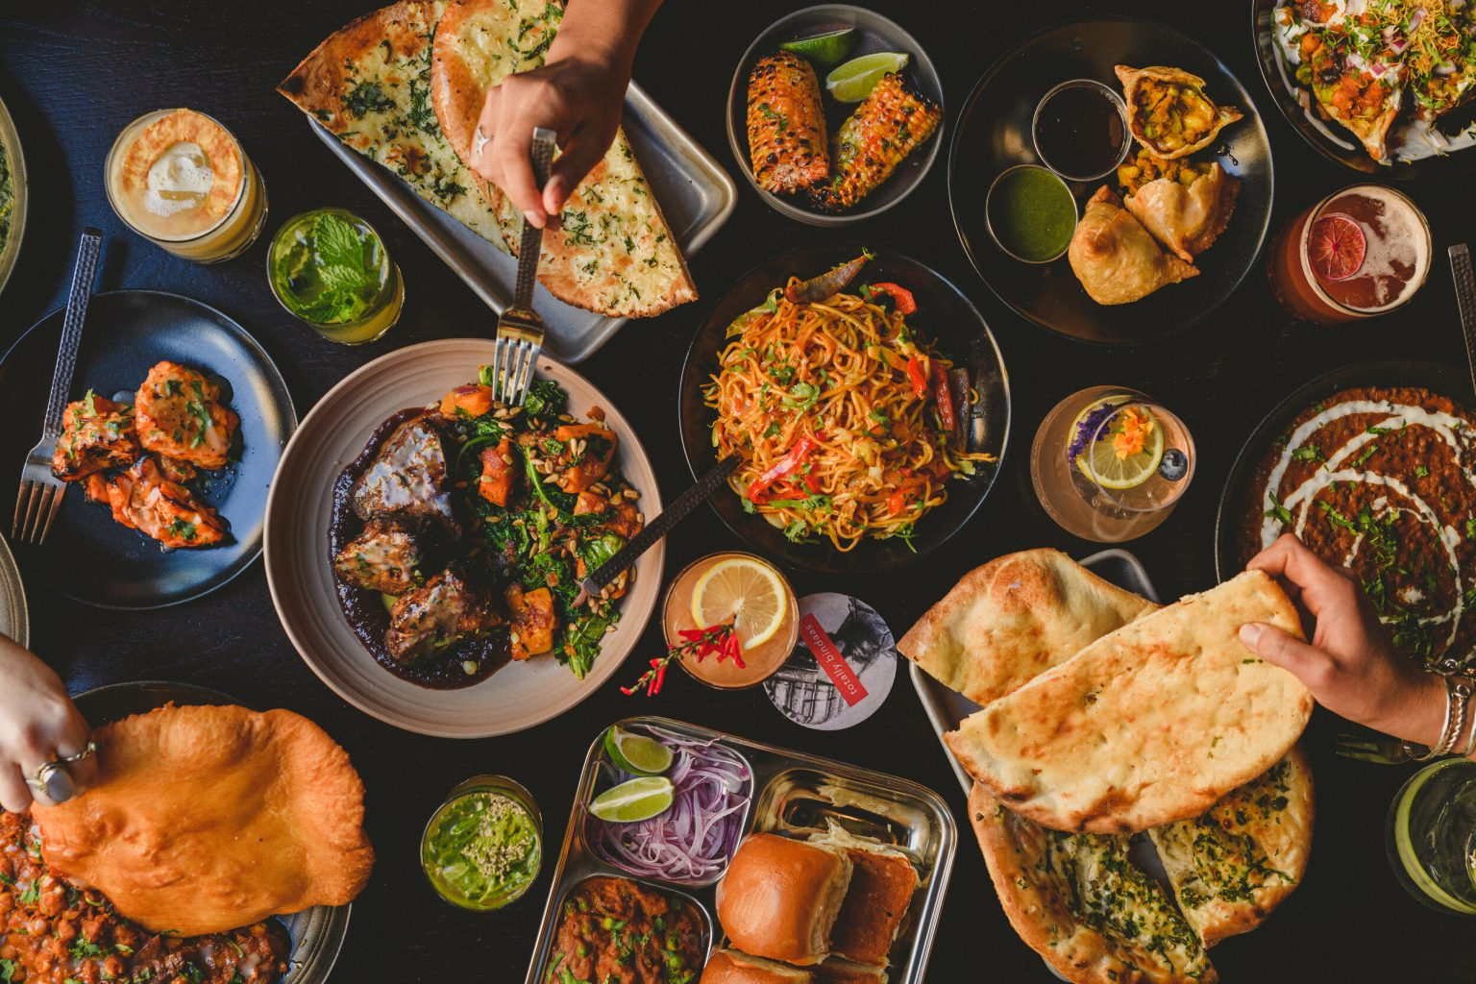
ONLINE
FOOD DELIVERY MANAGEMENT SYSTEM

Slide 2
Overview:
Online Food Delivery System is command line application where a person creates an account or logins to it if already exists and selects a destination to order the food.
Now he/she can select menu page according to the destination selected where he/she can select the desired items and they are added to the cart.
After adding to the cart he can alter the items in order, billing will be done and total number of items , total price will be displayed.
The order will be confirmed and a delivery boy will be assigned to deliver the particular order that he/she has ordered with his/her contact details.

Slide 3
CLASS DIAGRAM :
Menu
PrintMessage() SelectMenu() SearchItems() SearchByPrice() Count() Sum() Avg()
Implements Extends
Account
Firstname - String Lastname - String Email - String Password - String Address - String Phoneno - String DOB - ProjDate
PrintMessage() Account() CreateTable() Create_Account() Login_Account() Edit() getdetails() Delete() Checking()
ProjInterface
PrintMessage() Rating()
Cart
items - ArrayList<Integer> quantity – ArrayList<Integer>
PrintMessage() AddToCart() Bill() SortItems() Alter()
CommandLineArg
toString()
ProjDate
Date - int Month - int Year - int
toString()
DeliveryBoy
AssignDeliveryBoy() PrintMessage() Rating()

Slide 4

A VERY HAPPY
AND
HEALTHY LIFE

